Slide 1
Northspine Canteen
Real-time App
Group 5
Lam Jing Xuan Denise U1922510E
Lee Yi Hui Rachel U1922672E
Le Quang Anh U1922940J

Slide 2
A short demo...

Slide 3
Overall Plan for Program
Graphic User Interface
Store information in excel files

Slide 4
Start
Plan to eat now?
No
Input date and time
Yes
Set date and time to be input date and time
Set date and time to be current date and time
Show list of stores at chosen date and time

Slide 5
Show list of stores at date and time
Choose store
Open?
Yes
No
Inform user
Show menu
Operating Hours
Input number of people
Estimated waiting time

Slide 6
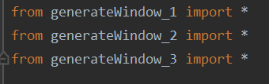
Program organization: function, module
Main file
Other files: contains code for 1 window each Eg: generateWindow_2(parameters)
Notes:
For our program, we have a main file and each other file contains a code for 1 window. This would allow our code to be more organised and readable.
An interesting approach we use is that we define the window function with some parameters => hence can use the same function to display windows with different settings (eg only show menu when store is open)

Slide 7
External library used
tkinter for GUI
pandas for reading the .csv data file
datetime to handle date and time data

Slide 8
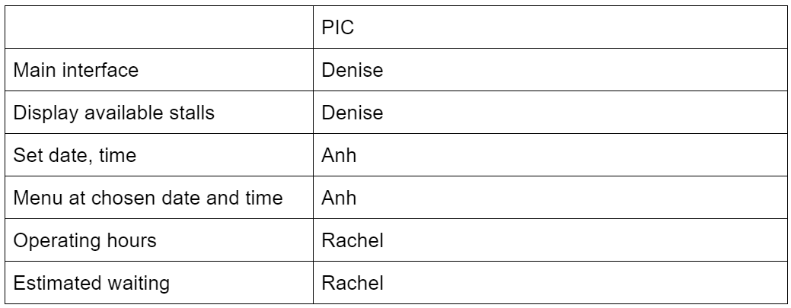
Contribution

Slide 9
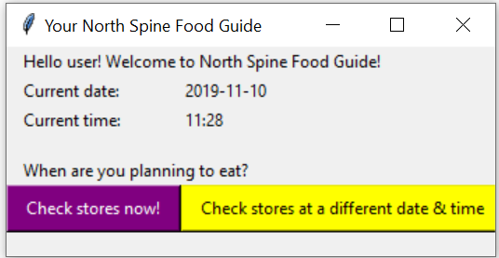
1st Window - Main Interface
Notes:
Write associated code and window

Slide 10
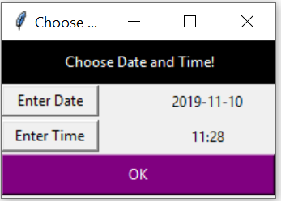
2nd Window - Date and Time

Slide 11
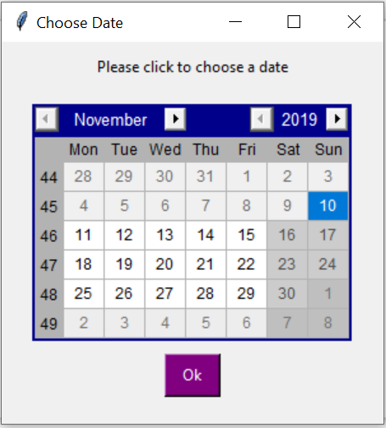
Date - a calendar
Use of tkcalendar.Calendar
Can only click within 1 year from current date
=> No exception handling required
Notes:
Date: a calendar that can choose 1 year from current date (1 year because the stores may change significantly

Slide 12
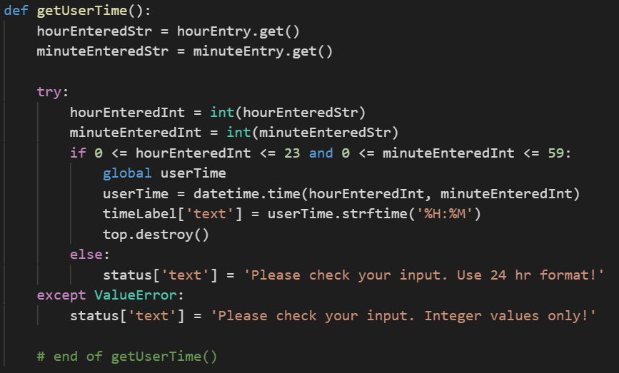
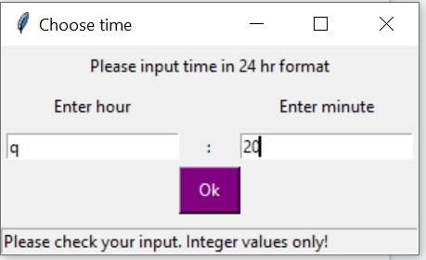
Time - string operation, input handling
Try-except to check error
Status bar to warn user
No need for loop
Str => int => datetime.time object
Status bar
Notes:
Use of status bar to warn user of bad input
We don’t have to use a loop for this because we code it such that the screen only closes when correct input is entered

Slide 13
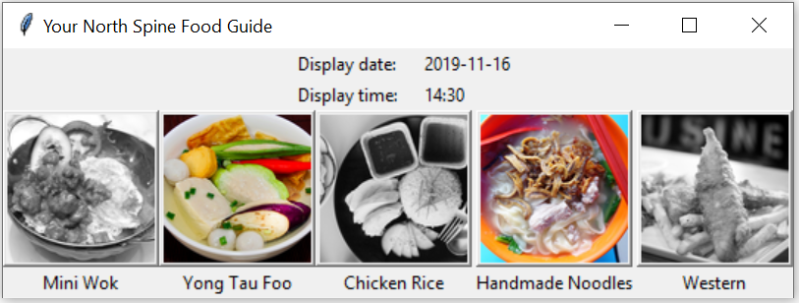
3rd Window, Stall Interface
Open store: coloured pictures
Closed store: grayscale pictures
Notes:
This is achieved through file handling

Slide 14
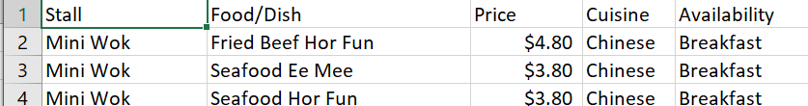
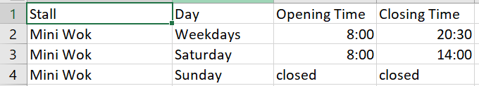
File system
stallList.csv
stallMenu.csv
operatingHours.csv

Slide 15
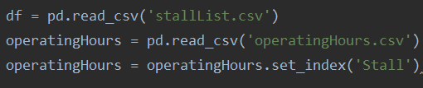
Stall Interface - File Handling
Use pandas to load the information as dataframe

Slide 16
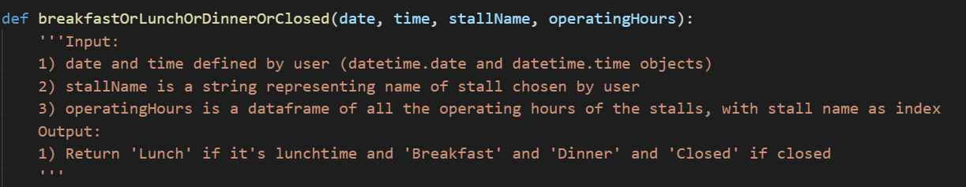
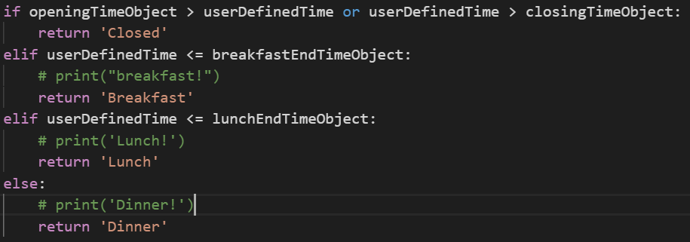
Stall Interface - File Handling
Notes:
The function is used to return the status of the store, by getting information such as openingTime, closingTime, and then compare these with the date and time chosen by user (either now or some defined time). The status is used to decide whether to display as coloured image or grayscaled

Slide 17
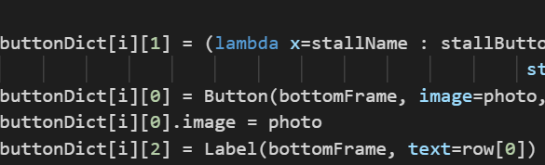
Stall Interface - Use of Dictionary
Automatically generating the buttons and label
Refer to them at ease

Slide 18
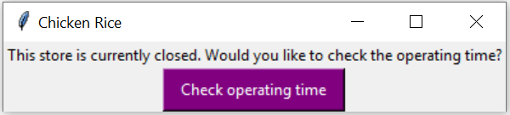
4th Window, Stall Menus (closed)

Slide 19
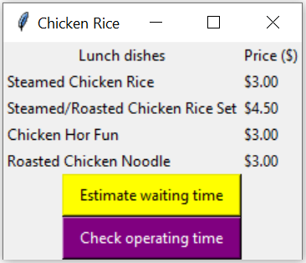
4th Window, Stall Menus (open)

Slide 20
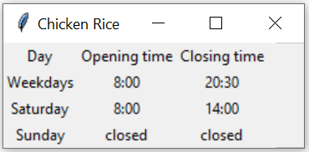
5th Window, Operating Hours

Slide 21
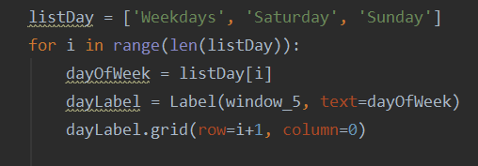
Operating hours - Use of list
Notes:
In order to display the operating hours of the respective stores, we made use of a list with the elements ‘weekdays’, ‘saturday’, and ‘sunday’. Following this, we iterate through the list and the relevant operating hours will be extracted and then, printed.

Slide 22
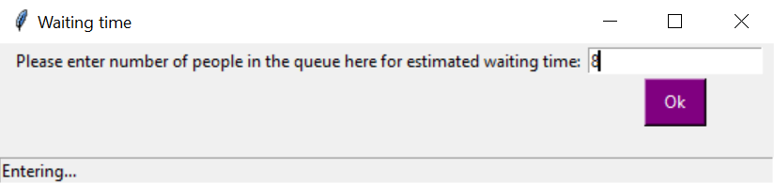
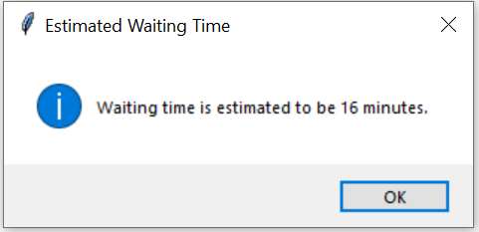
6th Window, Estimated Waiting Time
Notes:
The error handling for the estimated waiting time is similar

Slide 23
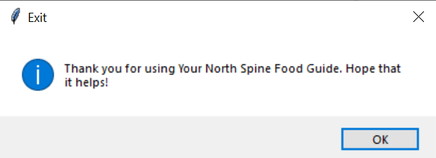
Message box: Thank You For Perusing!

Slide 24
Thank you!

Slide 25
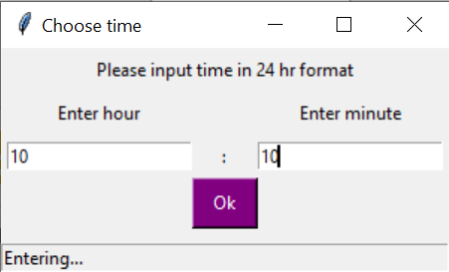
Time
Convert input into time object

Slide 26
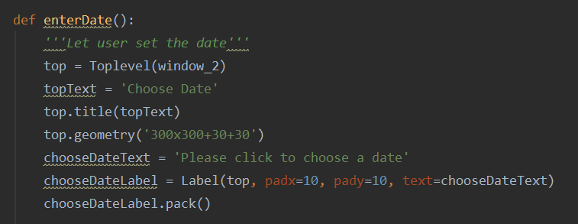
Rubrics - Use of string operations/functions

Slide 27
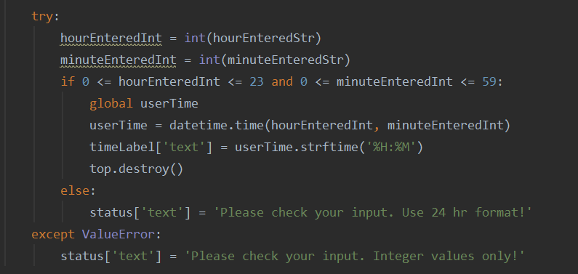
Rubrics - Exception Handing

Slide 28
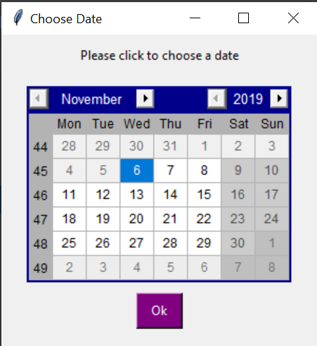
Extra features/Creative Solution

